Slide 1
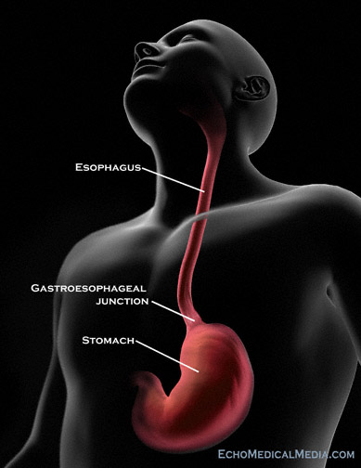
Dilated Dense-Unet for Esophageal Gross Tumor volume Segmentation in CT images
(3D Convolutional Neural Networks)
Sahar Yousefi
LKEB
Leiden
Notes:
Thank you for coming to my presentation

Slide 2
Problem & Challenges
The problem definition and challenges

Slide 3
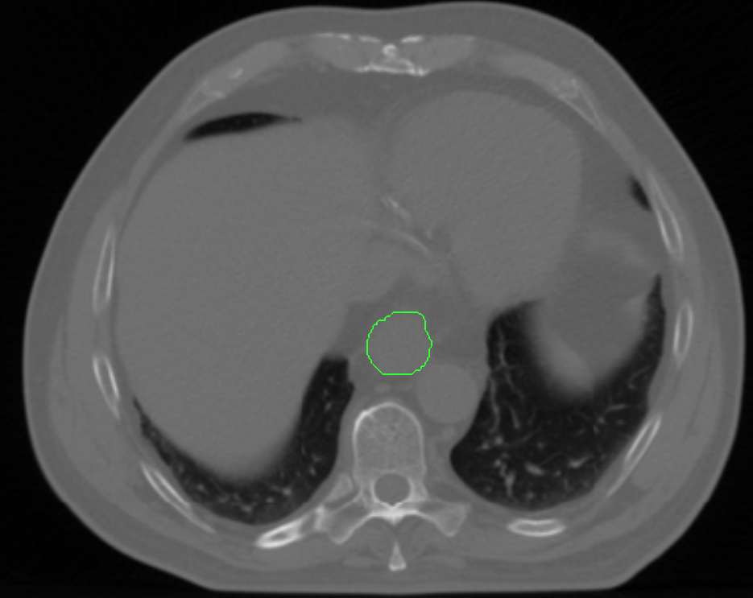
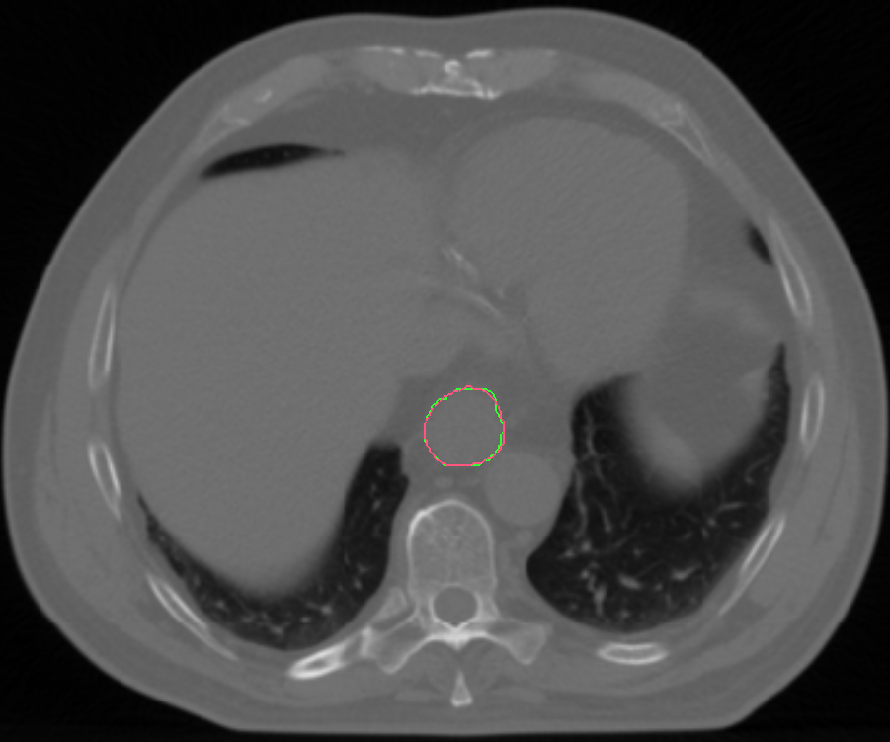
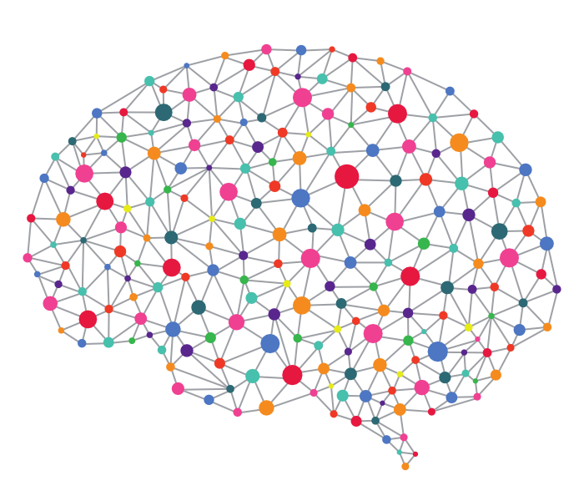
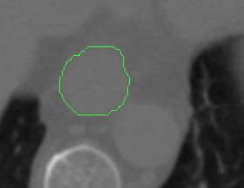
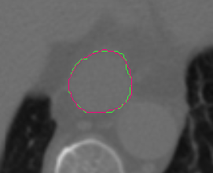
Problem definition
Designing a Convolutional neural network for automating the process of esophageal GTV segmentation in CT images
CNN
GTV in Ground truth
Output of the method

Slide 4
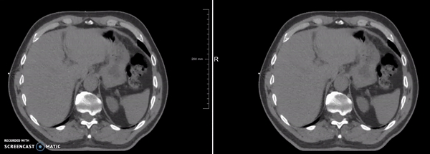
Manual delineation challenge
without delineation
with delineation
Low contrast of tumor
Notes:
Here the left figure shows the ct scan of one patient with esophageal cancer without delineation and the right figure shows the delineated tumor in that scan
If one looks at the left image, it is really hard to say when the tumor starts and when it stops

Slide 5
Manual delineation challenges
For manual delineation of tumor in CTs Physicians use additional knowledge:
A combination of clinical history
Endoscopy findings
Other imaging modalities (PET)
Obtaining this data is hard, time consuming and expensive! ☹
Still is an ill-posed problem!! ☹
Notes:
Developing an automatic and reliable approach for esophageal GTV segmentation is desirable

Slide 6
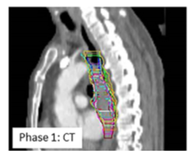
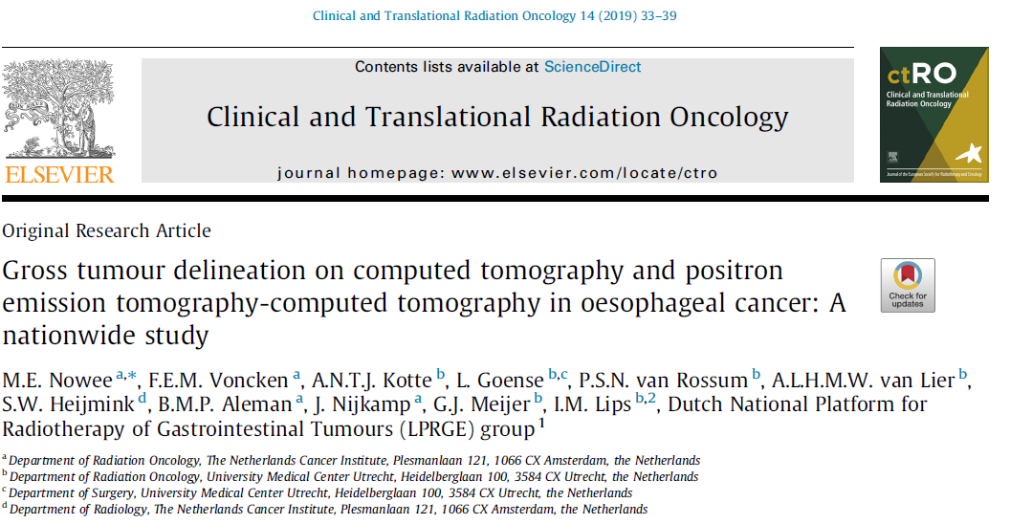
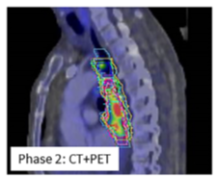
Manual delineation still is an ill-posed problem!
Goal: assessing delineation variability of the GTV between CT and combined PET-CT in esophageal cancer patients in a multi-institutional study
PET significantly influenced the delineated volume in some cases, however its impact on observer variation was limited
Phase 1- The GTV of the primary tumour was delineated by 20 observers on CT, with available clinical and diagnostic information
Phase 2- After fusion of the FDG-PET scan, the GTV was
adjusted based on the visual interpretation of the FDG-PET scan

Slide 7
OUR Previous work
Flash back

Slide 8
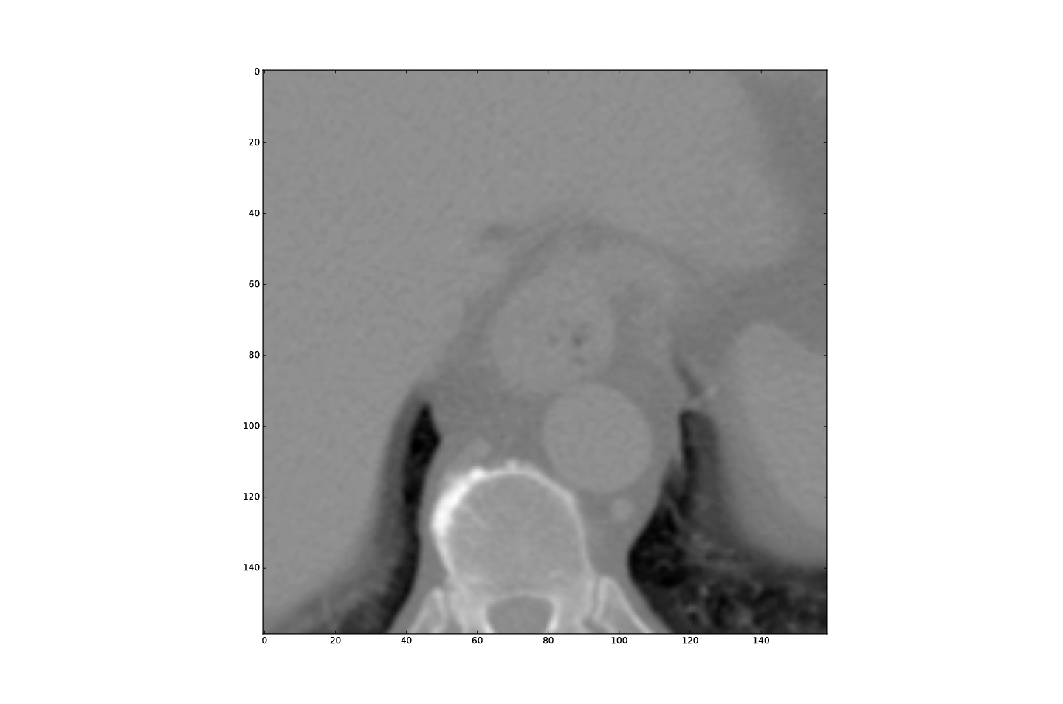
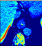
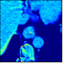
Problem of the traditional CNN connectivity
Typical CNN layers
Issue: information can wash out by the time it reaches the end of the network!
Solution: Loop connectivity pattern
Conv
Conv
Conv
…
Conv
Conv
Conv
Notes:
Issue: As information passes through many layers, it can vanish and wash out by the time it reaches the end /or beginning of the network!

Slide 9
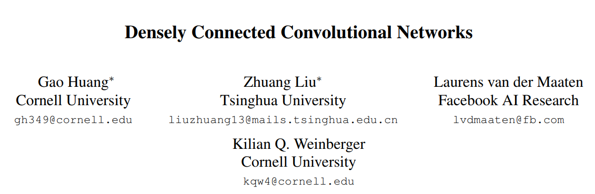
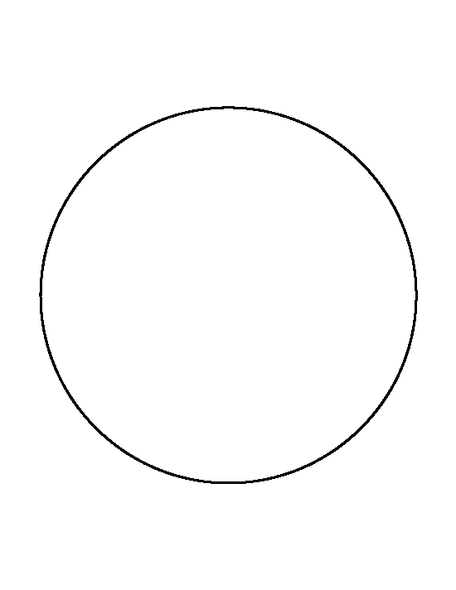
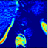
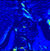
Advantages:
Improve the flow of information and gradients throughout the network
Leads to feature re-usability
+
+
+
+
+

Slide 10
Advantages:
Improve the flow of information and gradients throughout the network
Leads to feature re-usability
Dense Block (DB)
+
+
+
+
+

Slide 11
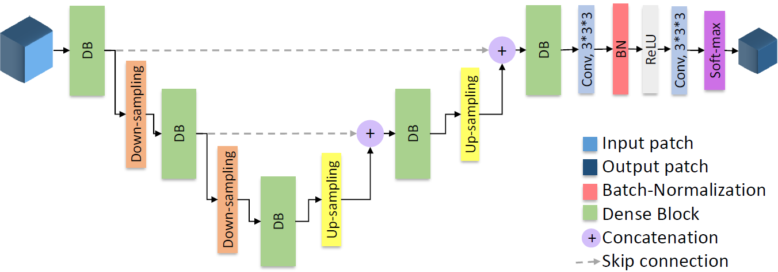
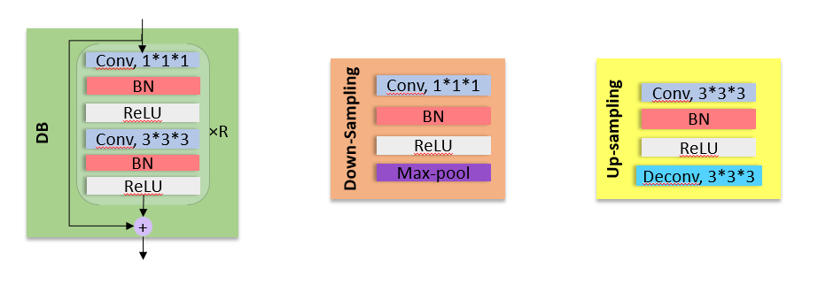
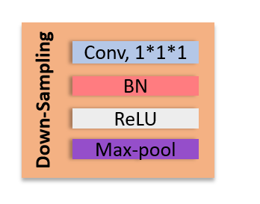
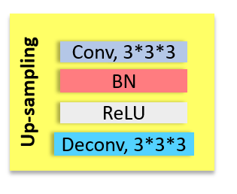
Our previous work
Yousefi, Sahar, et al. "Esophageal Gross Tumor Volume Segmentation Using a 3D Convolutional Neural Network." MICCAI 2018.

Slide 12
Dataset- the MICCAI paper
Dataset 1: contains 21 distinct patients
For each patient: five repeat CT scans captured at different time points.
For three time points, there was one 3D CT scan,
For two time points there were one 3D CT scan and one 4D CT scan (consisting of 10 breathing phases)
Dataset 2: contains 29 distinct patients
A single 3D CT scan per each patient
Delineation:
For each scan there was a corresponding esophageal GTV segmentation
Dataset 1: done by one physician
Dataset 2: done by multiple physician!
Scanning protocol and scanners:
Same for the both dataset

Slide 13
Results
Eight (8/85) scans had a DSC<0.50
Mostly caused by the presence of air cavities and foreign bodies (feeding tubes, surgical clips) in the GTV
Were rarely seen in the training data

Slide 14
Current work

Slide 15
Contributions
Data:
Enriched the 2nd dataset with 120 scans from 120 distinct patients
Network structure
Leveraged dilated convolutional layers in Dense blocks
Increasing the receptive field
Managing GPU memory

Slide 16
Dataset- present work
Dataset 1: contains 21 distinct patients
For each patient: five repeat CT scans captured at different time points.
For three time points, there was one 3D CT scan,
For two time points there were one 3D CT scan and one 4D CT scan (consisting of 10 breathing phases)
Dataset 2: contains 106 distinct patients
A single 3D CT scan per each patient
Delineation:
For each scan there was a corresponding esophageal GTV segmentation
Dataset 1: done by one physician
Dataset 2: done by multiple physician!
Scanning protocol and scanners:
Same for the both dataset

Slide 17
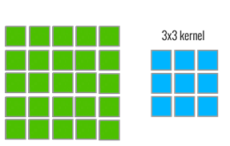
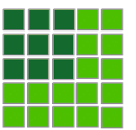
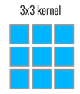
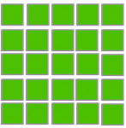

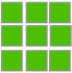

Receptive field
The region in the input space that a particular CNN’s feature is effected by
input
CNN
CNN
Conv
Receptive field: 3*3
Conv
Conv
Receptive field: 5*5

Slide 18

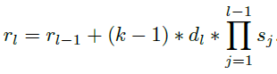

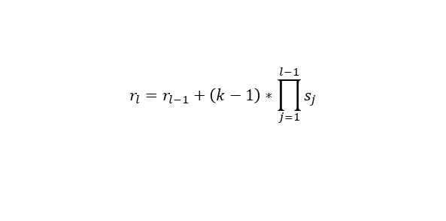
Dilated convolutional layer
Exponential expansion of the receptive field
Receptive field of a Conv layer:
Standard Convolution
Receptive field of a max-pool layer:
$$r_{l}=r_{l−1}+\left(k−1\right)∗\prod_{j=1}^{l−1}{s_{j}}$$
k=kernel size
p=padding
s=stride
d=dilation
Dilated Convolution

Slide 19
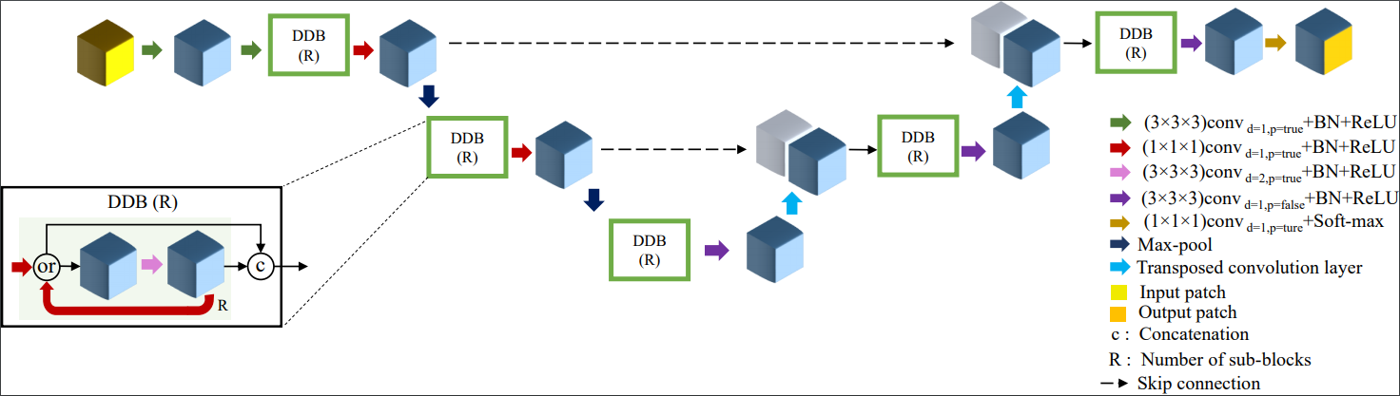
Proposed architecture
Receptive field increased:
from 43*43*43 (in MICCAI work) to 61*61*61

Slide 20
Training and testing details
The network is trained patch based
Manages the GPU memory limitation
Increases data
Reduces overfitting
Multithreading has been used for extracting the patches
Patch extraction is done in parallel with training the network
While the GPU is busy with training the network by the current patches, the next patches are extracted to be ready for the next feeding
Data augmentation
Adding noise randomly to the patches
Managing the data imbalance problem (ratio of tumor vs background is low)
Patches mostly are extracted from tumor region (75%)

Slide 21
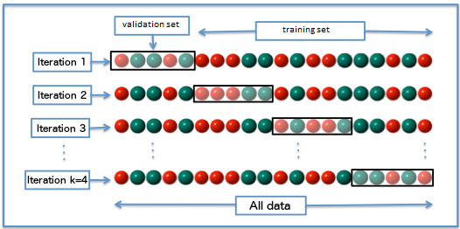
Training and testing details
Data has been splitted in
Training set
Validation set
Test set
For evaluation the network 4-fold cross validation has been used
Experimental results have been done in three steps
Experiment #1: using the both datasets for training
Experiment #2: using only the second dataset for training
Experiment #3: using only the first dataset for training

Slide 22
Experimental results
Experimental results

Slide 23
DSC value for one fold of the 1st experimental trial
6 patients from the 1st dataset
25 patients from the 2nd dataset

Slide 24
Mean surface distance for one fold of the 1st experimental trial
6 patients from the 1st dataset
25 patients from the 2nd dataset

Slide 25
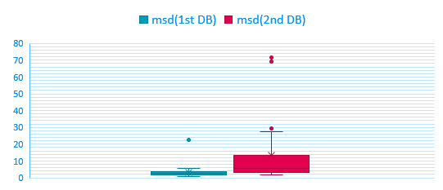
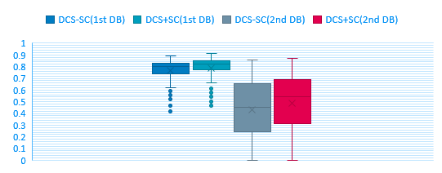
Comparison between the result of the 1st dataset and the 2nd dataset
DSC-SC: results of the output of the network
DSC+SC: selecting the component which has an overlay with the ground truth manually

Slide 26
Results- 4 different folds (the 1st experimental trial: Training on the both datasets)
Dataset #2
Dataset #1

Slide 27
Results- 4 different folds (the 2nd experimental trial: training only on the second dataset)
Dataset #2

Slide 28
Results- 4 different folds (the 3rd experimental trial: training only on the first dataset)
Dataset #2
Dataset #1

Slide 29
What is a CNN sensitive to?
Data!
Diversity of the cases
It is hard to find a good CNN if the data be too diverse
Cases which can be seen rarely (a few times) in training can not be segmented successfully in test set
Different shape of tumor
Different and rare anatomies
Diseases or disorders in the patients which is not common in the data
What we can do?
Inspection of the data!

Slide 30
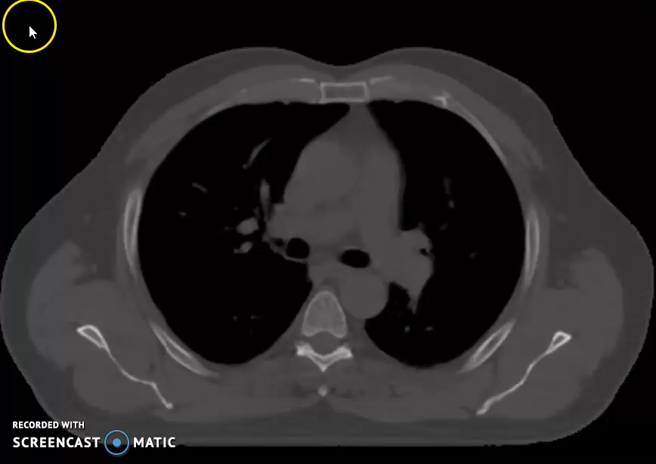
A successful case 1st dataset
Manual delineation
Network result
0.89 | 0.90
DCS-LC | DCS+LC

Slide 31
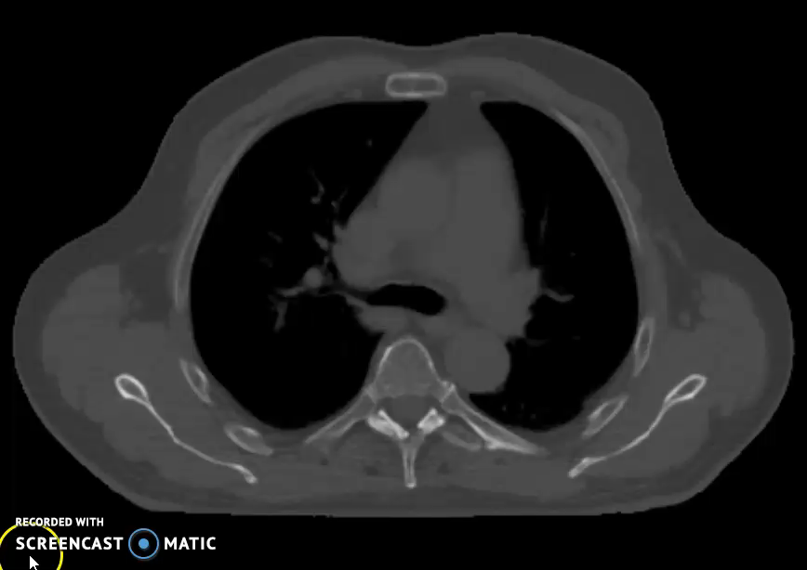
A successful case 1st dataset
Manual delineation
Network result
0.87 | 0.87
DCS-LC | DCS+LC

Slide 32
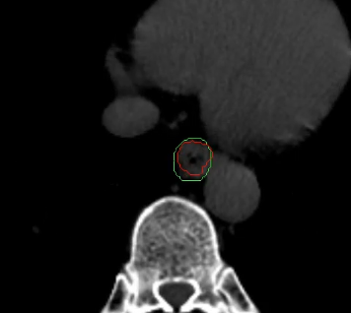
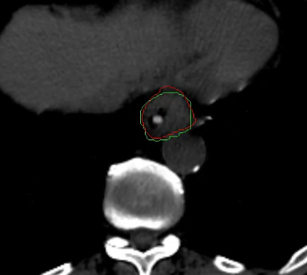
A patient with some air pockets and a feeding tube
Air pocket
Feeding tube
Manual delineation
Network result

Slide 33
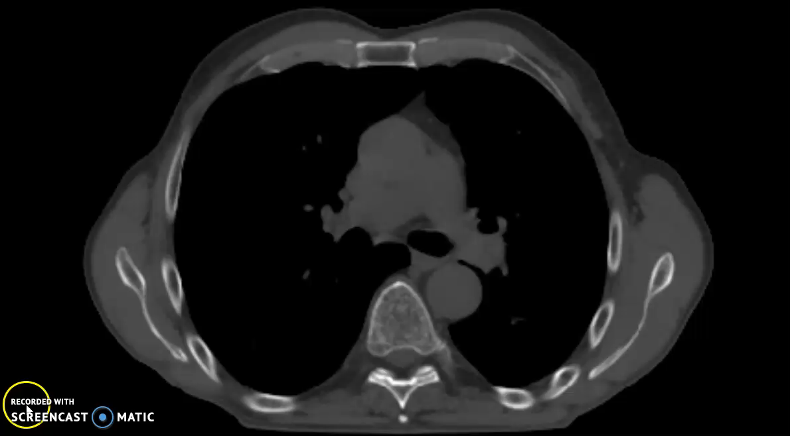
Not a very good case
Manual delineation
Network result
0.6 | 0.65
DCS-LC | DCS+LC
Notes:
Test 99

Slide 34
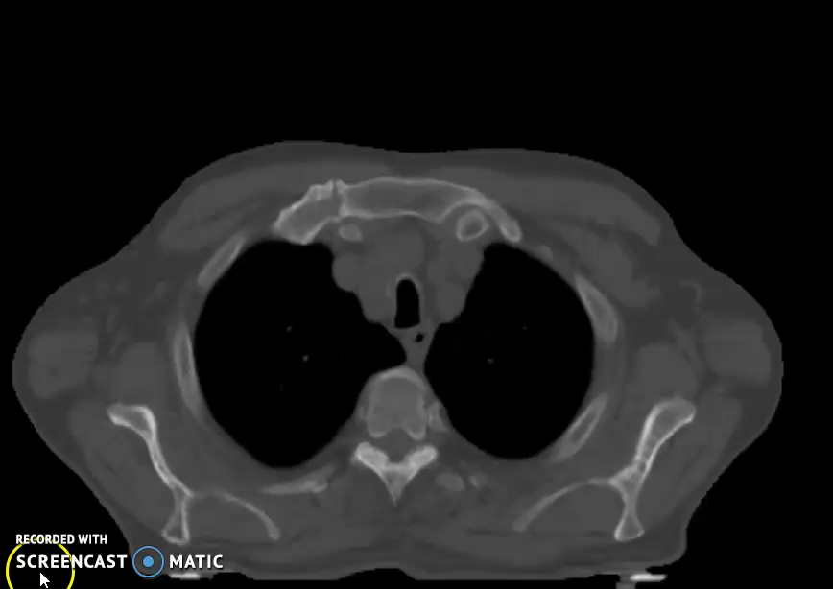
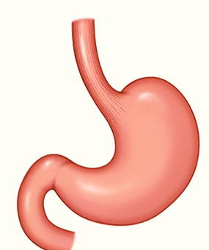
Not a good case
0.42 | 0.46
DCS-LC | DCS+LC

Slide 35
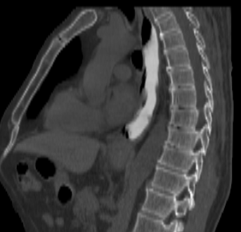
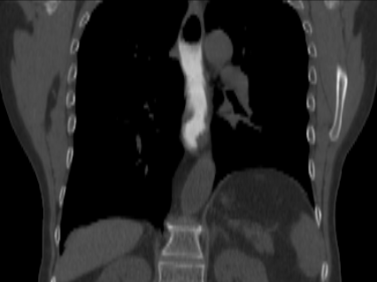
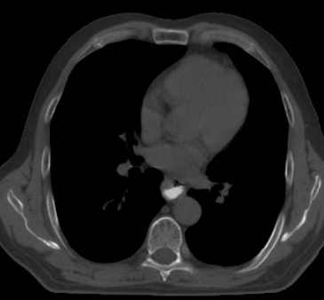
Difficulty raised by using contrast agent
Usually contrast agents are not used for GTV delineation!
we have a couple of scans with contrast agents in the dataset
Esophagus

Slide 36
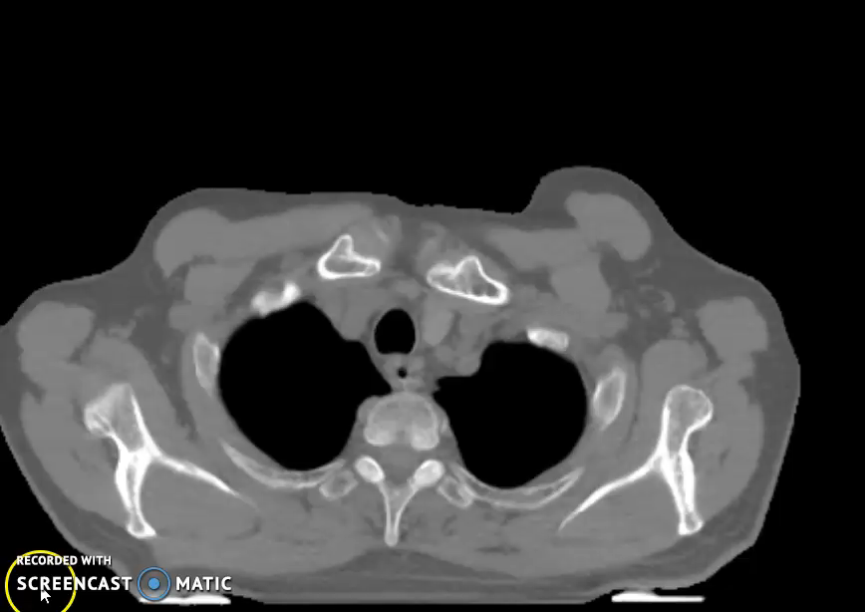
A failure case: difficulty raised by contrast agent
Manual delineation
Network result
0.31 | 0.4
DCS-LC | DCS+LC
Notes:
Test 026

Slide 37
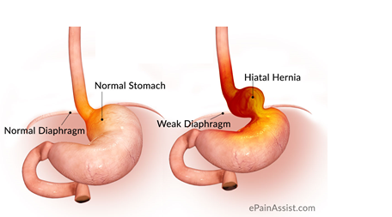
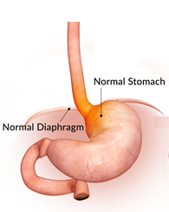
Anatomy variations: -Hiatal hernia
The hiatus is an opening in the diaphragm
In a hiatal hernia the stomach bulges up into the chest through hiatus

Slide 38
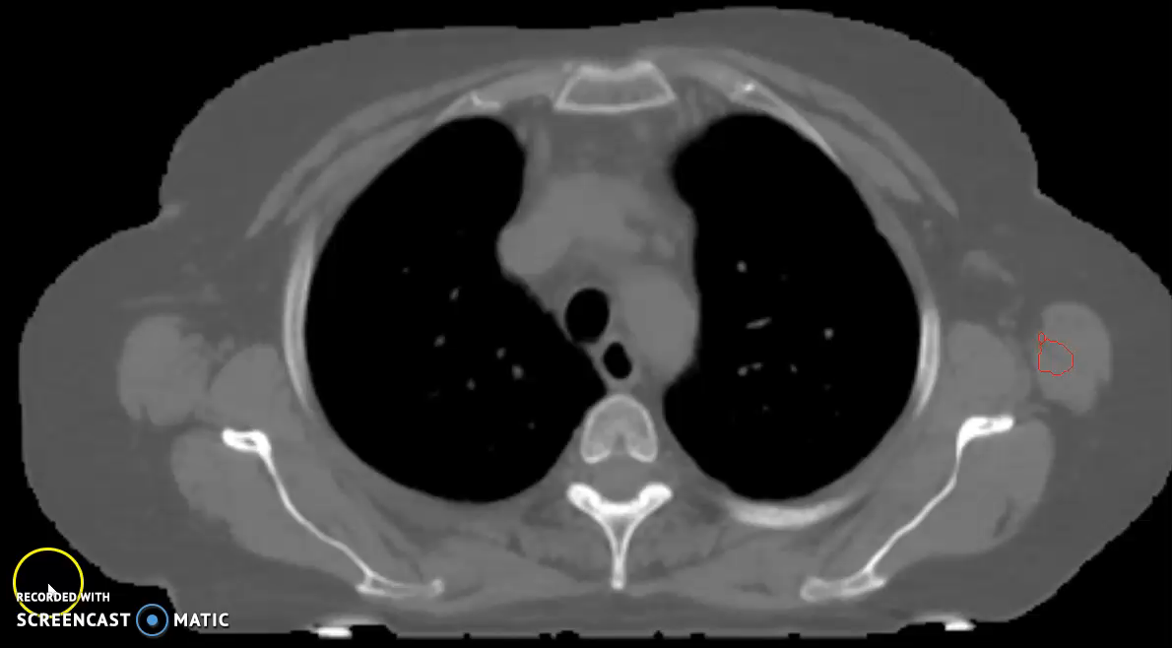
A failure case: a patient with hiatal hernia Anatomy variation
Manual delineation
Network result

Slide 39
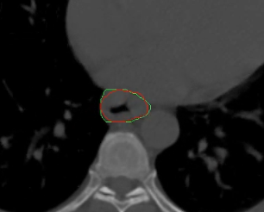
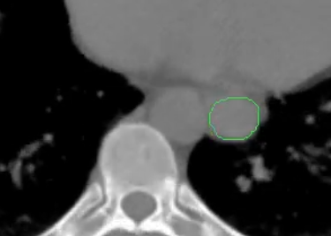
Anatomy variations: -Esophagus location variation
In most of the cases esophagus is located in front of spine and left of aorta!
In some patients the esophagus has moved to the right of aorta!
Aorta
Spine
Aorta
Spine
Manual delineation
Network result

Slide 40
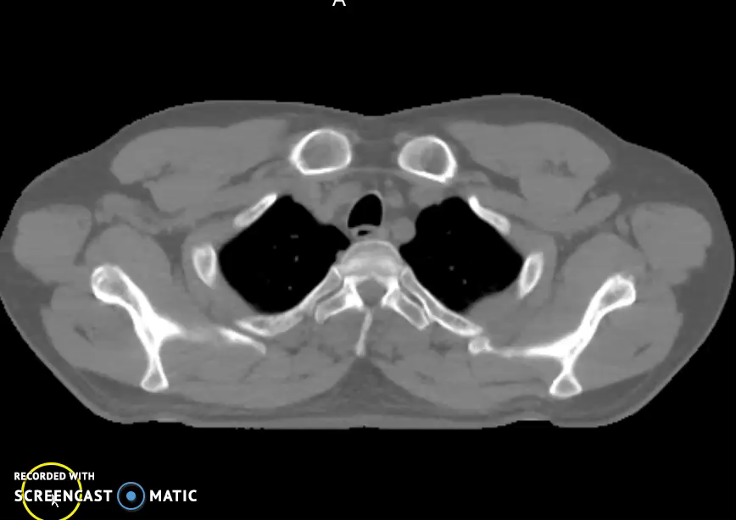
A failure case: a patient with esophagus location variation
Manual delineation
Network result
0.03 | 0.05
DCS-LC | DCS+LC
Notes:
Variation of esophagus 5%
Test 033

Slide 41
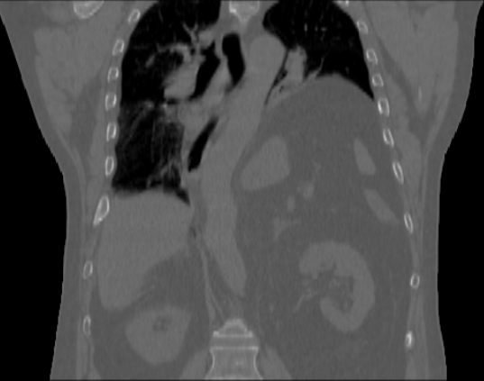

Anatomy variations: Part of the lung has been removed!
Esophagus

Slide 42

A failure case: difficulty raised by a different anatomy
Manual delineation
Network result
0 | 0
DCS-LC | DCS+LC

Slide 43


Anatomy variations: Absence of fat around the esophagus!
Fat around the esophagus has been lost!
Esophagus

Slide 44

A failure case: difficulty raised by a different anatomy
Manual delineation
Network result
0.10 | 0.20
DCS-LC | DCS+LC
Notes:
test097

Slide 45
Conclusions
Conclusions

Slide 46
Conclusion
What we did?
Enriched the data compared to our previous work
A bigger dataset with more diversity
Used dilated layers for increasing the receptive field of the network
Due to its difficulties, the problem of automating the esophageal GTV segmentation has not been touched too much
There are only a few literatures in this field
Data diversity is one of the most challenging issues in this problem
Enriching the dataset with similar cases can be helpful
This work shows that using CNN for this purpose is very promising

Slide 47

Thank you for your attention!

